Slide 1
Chapter 5: Common Administrative Tasks
Instructor-led overview and operational guidance

Slide 2
Learning Objectives
01 Explain the key administrative ideas in Chapter 5
02 Identify the relevant Windows Server tools, workflows, and decision points
03 Relate the topic set to real operational and security practices
04 Prepare for later hands-on administration and troubleshooting work
Windows Server 2025 | Chapter 5 | Common Administrative Tasks
02

Slide 3
Chapter Topics
01 5.1 Managing roles and features
02 5.2 Managing services
03 5.3 Reviewing events
04 5.4 Configuring firewall
05 5.5 Patch management
Windows Server 2025 | Chapter 5 | Common Administrative Tasks
03

Slide 4
5.1 Managing Roles and Features
Roles and features control server capabilities.
Use Server Manager GUI or Install-WindowsFeature PowerShell cmdlet to add or remove roles
Roles have optional role services and feature dependencies that must be resolved at install
Management tools are not included by default via PowerShell — add -IncludeManagementTools
Add -Restart to auto-reboot if required; use -WhatIf to preview changes first
Can target local, remote, or offline VHD with -ComputerName or -Vhd parameters
Use Get-WindowsFeature to list all available and installed roles before making changes
Windows Server 2025 | Chapter 5 | Common Administrative Tasks
04

Slide 5
5.2 Managing Services
Services control background processes.
The Service Control Manager (SCM) manages all service lifecycle — starting, stopping, and recovery
Startup types: Automatic, Automatic (Delayed), Manual, Trigger Start, and Disabled
Use services.msc (GUI) or Get-Service / Start-Service / Stop-Service (PowerShell)
Services run under identity accounts: Local System, Network Service, Local Service, or gMSA
Configure recovery actions (restart, run program, reboot) for first, second, and subsequent failures
Never stop the Windows Defender Firewall service (MpsSvc) directly — disable profiles instead
Windows Server 2025 | Chapter 5 | Common Administrative Tasks
05

Slide 6
5.3 Reviewing Events
Events show system behavior and problems.
Core logs: Application, System, Security, and Setup — access via eventvwr.msc
Use Get-WinEvent (modern cmdlet); replaces deprecated Get-EventLog for all Windows Vista+ logs
Filter efficiently with -FilterHashtable: LogName, Id, Level, StartTime, ProviderName
Key event IDs: 6005/6006 (startup/shutdown), 1074 (planned reboot), 6008 (unexpected shutdown), 4719 (audit policy change)
Create Custom Views in Event Viewer to filter by source, level, or event ID across multiple logs
Audit policy must be configured via GPO — many security events require explicit audit enablement before they appear
Windows Server 2025 | Chapter 5 | Common Administrative Tasks
06

Slide 7
5.4 Configuring Firewall
Firewall controls network exposure.
Three profiles: Domain, Private, and Public — rules apply per active network profile
Default behavior: all inbound blocked, all outbound allowed; create allow rules for exceptions
Use wf.msc (Advanced Security console) or New-NetFirewallRule PowerShell cmdlet
Rules specify: direction (inbound/outbound), protocol/port, program path, remote address scope, and action
Deploy consistently across environments via Group Policy (GPO) for domain-joined servers
Never disable the MpsSvc service — use profile disable instead to avoid losing IPsec and Windows Service Hardening
Windows Server 2025 | Chapter 5 | Common Administrative Tasks
07

Slide 8
5.5 Patch Management
Patch management is a lifecycle, not a one-click task.
Traditional tools: WSUS (deprecated but supported) and Windows Update via Group Policy
Modern approach: Azure Update Manager provides unified patching for on-premises and cloud servers via Azure Arc
Windows Server 2025 supports Hotpatch — security updates applied in-memory without a reboot (requires Azure Arc + VBS)
Hotpatch cycle: Cumulative Update baseline every 3 months; hotpatch months in between require no restart
Always define maintenance windows, validate services after patching, and document every change
Windows Server 2025 | Chapter 5 | Common Administrative Tasks
08

Slide 9
5.5a Hotpatch - Security Updates Without Reboots
Hotpatch installs security updates in memory — no reboot required.
Patches the in-memory code of running processes without restarting them — applications continue uninterrupted
Builds upon a Cumulative Update (CU) baseline established every 3 months (requires a reboot); hotpatch months in between do not
Annual cadence: 4 baseline months (with reboot) + 8 hotpatch months (no reboot) per year
Covers Windows security updates only — non-security, driver, and firmware updates still require a reboot
Prerequisites: Windows Server 2025 Standard or Datacenter (build 26100.1742+), VBS/VSM enabled, UEFI with Secure Boot
On-premises servers require Azure Arc connection + Azure Update Manager; Azure VMs get it automatically via Azure Automanage
Benefits: faster installs (smaller packages), reduced attack exposure window, less change-control planning, and higher server availability
Windows Server 2025 | Chapter 5 | Common Administrative Tasks
09

Slide 10
5.5b Windows Autopatch - Client Devices Only
Windows Autopatch automates update management — but only for Intune-enrolled Windows clients.
A cloud service embedded in Microsoft Intune that manages Windows, Microsoft 365 Apps, Edge, and Teams updates automatically
Deploys updates in sequential deployment rings (First, Fast, Broad) to minimise user disruption and catch issues early
Integrates with Hotpatch for eligible Windows 11 clients (Win 11 24H2, x64, VBS enabled) — security updates applied without restart
Why not Windows Server? Autopatch is Intune technology. Intune manages Windows client devices only — Windows Server is not supported
Server patch management uses WSUS, Azure Update Manager, Group Policy, or Configuration Manager instead
Requires: Windows 11 (or 10) Enterprise E3/E5, Microsoft 365 E3/F3, Business Premium, or Education A3/A5 licence; device must be Entra-joined and Intune-enrolled
Provides full reporting via Intune admin centre — compliance status, device health, and update blockers visible per policy
Windows Server 2025 | Chapter 5 | Common Administrative Tasks
10

Slide 11
Windows Autopatch
Definition: A Microsoft service that automatically manages the update process for Windows, Microsoft 365 Apps, Microsoft Edge, and Microsoft Teams.
Purpose: Ensures devices stay current and secure without manual patching.
Key Features:
Automated update deployment with minimal admin effort
Uses rings (Test, First, Fast, Broad) to safely roll out updates
Built-in monitoring, rollback, and reporting
Integrated with Intune and Entra ID
Benefit: Reduces risk, improves security posture, and ensures business continuity.

Slide 12
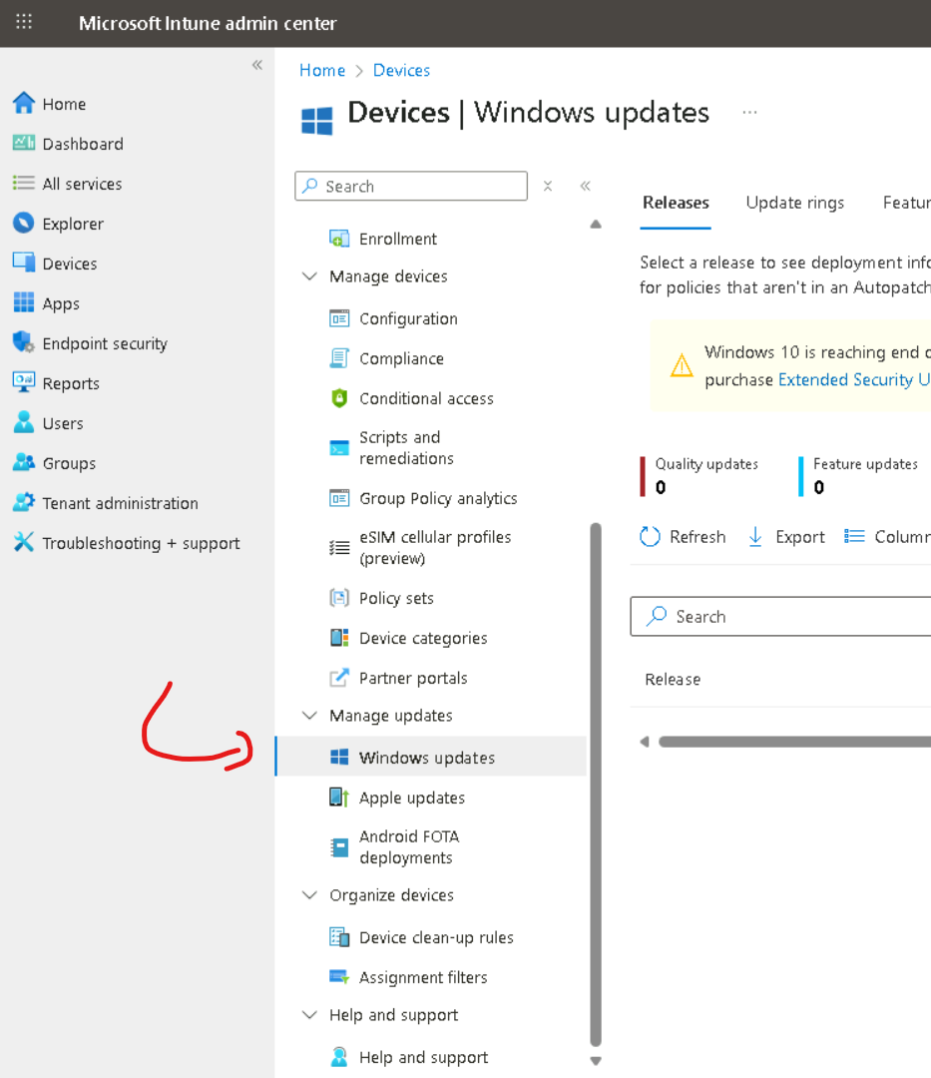
https://intune.microsoft.com
Devices >
Windows Updates

Slide 13
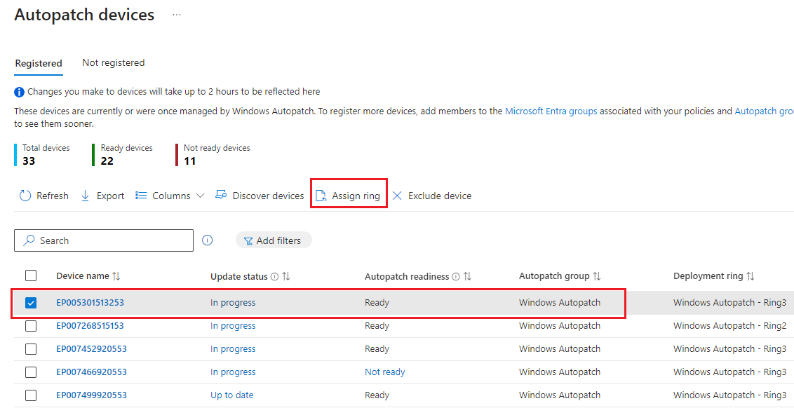
Moving devices between deployment rings
If we want to move separate devices to different deployment rings, after Windows Autopatch's deployment ring assignment, we can repeat the following steps for one or more devices from the Registered tab

Slide 14
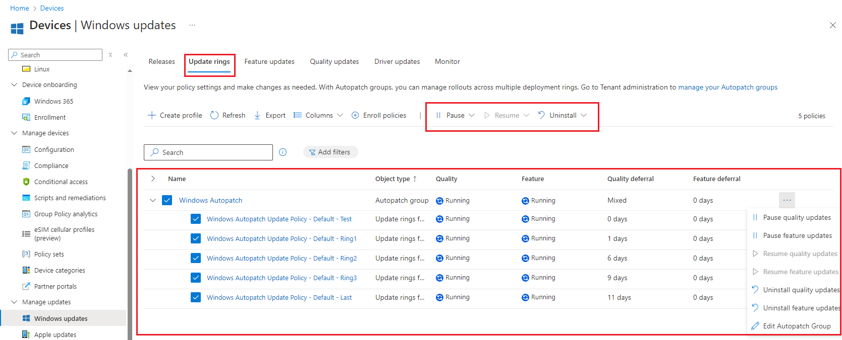
Pause || Resume updates
In the Update rings tab it is possible to pause updates, for example during EP session weeks and resume it just after the session

Slide 15
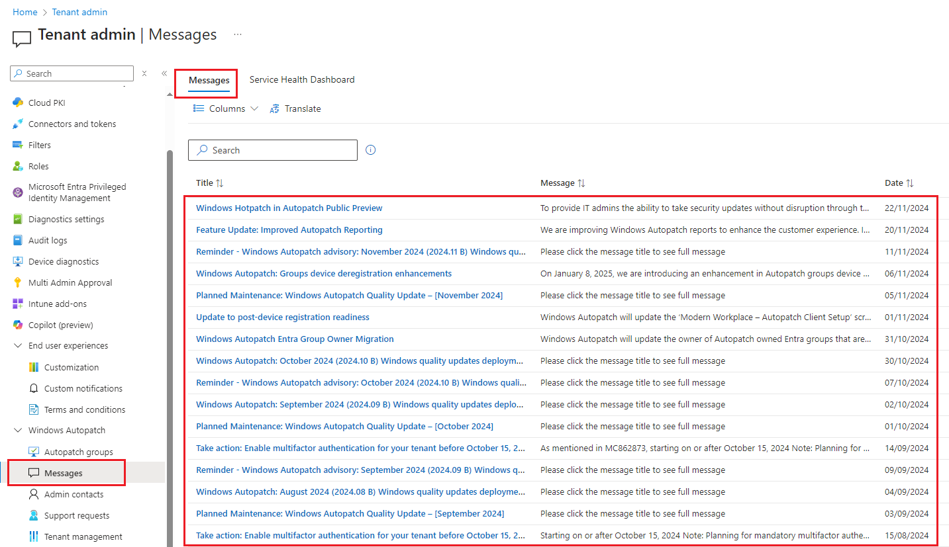
Release announcements
In this section Microsoft is publishing all new important security updates and release dates

Slide 16
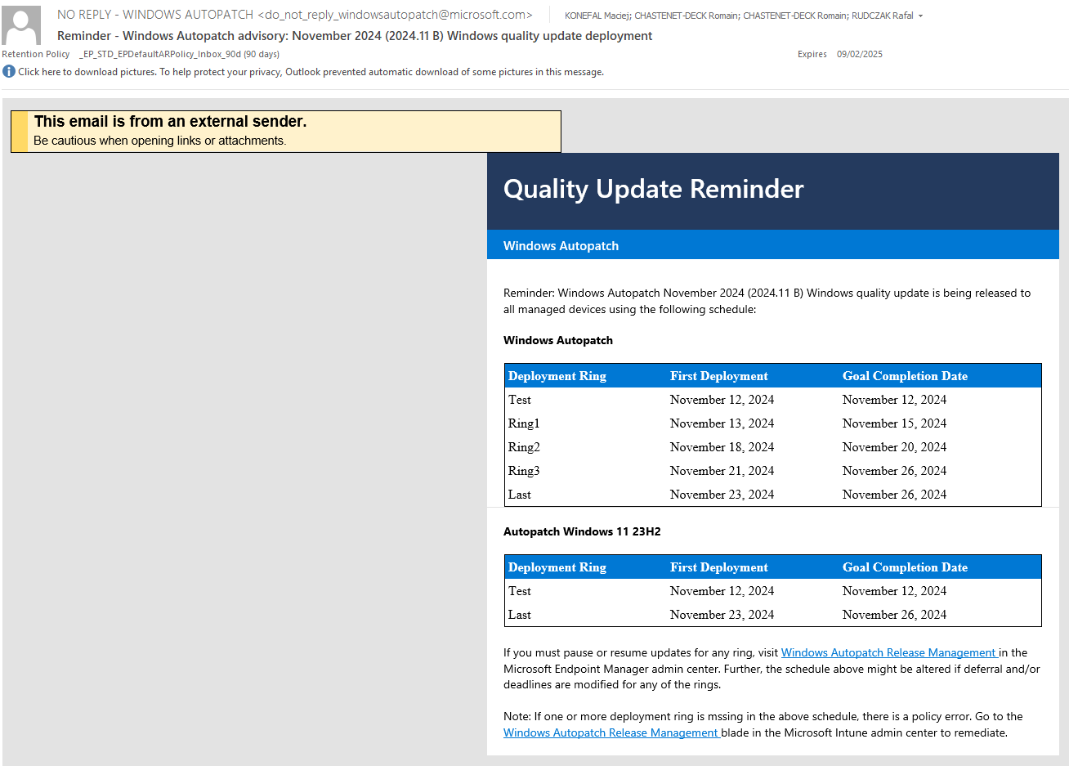
Release announcements
Additionally users, who are defined as a main and secondary contact persons during Windows Autopatch configuration | enrolment process will receive emails about planned Windows quality updates with deployment dates:

Slide 17
5.6 Installing Software with WinGet on Server 2025
WinGet is installed by default on Windows Server 2025 — the first Windows Server release to include it.
WinGet is the Windows Package Manager command-line tool — discover, install, upgrade, and remove applications consistently
Available on Desktop Experience only; not available on Server Core installations (no Microsoft Store dependency)
Run from Windows Terminal, PowerShell, or CMD — always as Administrator for system-wide installs
Key commands: winget search <name>, winget install --id <ID>, winget upgrade --all, winget list
Use --exact (-e) flag for precise matches; install multiple packages in one command by listing IDs separated by spaces
Use winget configure with a YAML + PowerShell DSC file to automate server onboarding — reliable and repeatable
Also supports winget export / import for saving and restoring full package lists across servers
Windows Server 2025 | Chapter 5 | Common Administrative Tasks
11

Slide 18
Chapter Summary
01 Translate administration concepts into daily operational work
02 Keep PowerShell and Server Manager aligned rather than teaching isolated click paths
03 Tie each task to security and change-control considerations
04 Reinforce repeatable administration, validation, and supportable design choices
Windows Server 2025 | Chapter 5 | Common Administrative Tasks
13

Slide 19
Knowledge Check
01 What is the main administrative purpose of Managing roles and features?
02 What is the main administrative purpose of Managing services?
03 What is the main administrative purpose of Reviewing events?
04 What is the main administrative purpose of Configuring firewall?
05 What is the main administrative purpose of Patch management?
Windows Server 2025 | Chapter 5 | Common Administrative Tasks
14

Slide 20
Lab 0501 | Installing Server Roles and Managing Firewall
PRACTICE LAB
Lab 0501
Installing Server Roles and Managing Firewall
In this lab, you will install a Windows Server role (Web Server/IIS) and manage Windows Firewall rules. You will use both Server Manager and PowerShell to accomplish these tasks. This lab demonstrates core administrative tasks that you will perform regularly.
Windows Server 2025 | Chapter 5 | Common Administrative Tasks
15

